Slide 1
Energy Generation Of US For Last 3 Decades Data Visualization

Slide 2

Introduction
We human beings have been using vast proportions of earth’s natural resources for our own needs. We use energy for or heating and cooling, lighting, heating water and operating appliances. Apart from that we use energy for many purposes, such as traveling in airplanes and cars using oil that is converted into gasoline.

Slide 3
Introduction Cont.
In USA, the Industrial sector accounts for 33 % of national electricity consumption followed by Residential and Commercial.
17 % of greenhouse gas emissions.
22 % of primary energy consumption.
Residential sector holds the potential for large energy.
Residential electricity consumption has historically been dominated by four end uses: lighting, heating, cooling, and household appliances.
Demand growth due to consumer electronics such as televisions, computers, and media playback devices.

Slide 4
Data Set
https://www.eia.gov/electricity/data/state/
Data Set has 49,550 rows and 5 attributes.
Dataset contains Electricity consumption information of 52 provinces of United States
Main Attributes are Year, State, Produce Type, Energy Source, Generation.

Slide 5
Analysis
Most used energy sources during the last 30 decades
Most energy consumed state
The producer which produced most energy
Total generated energy by sates
Trend of energy generation

Slide 6
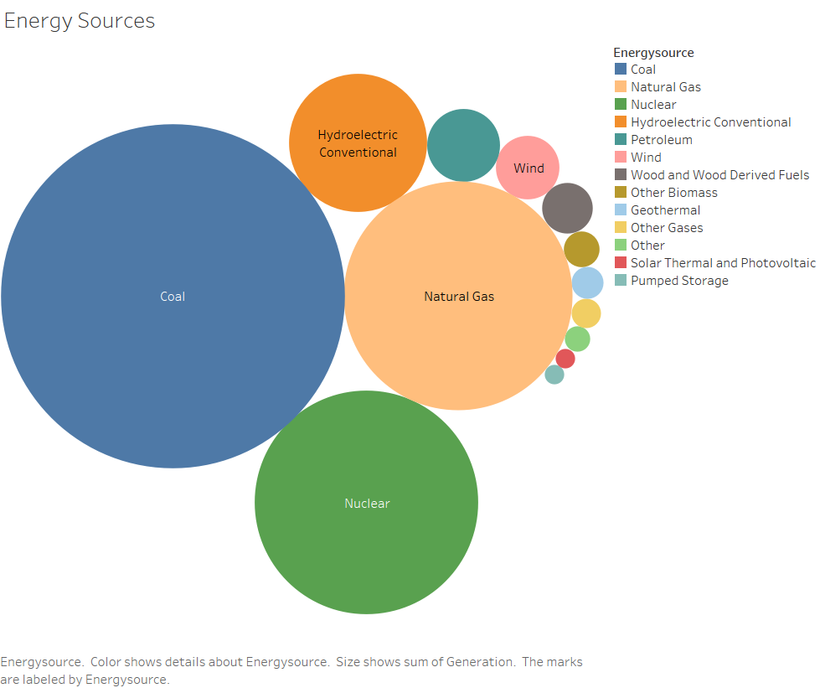
Energy Sources

Slide 7
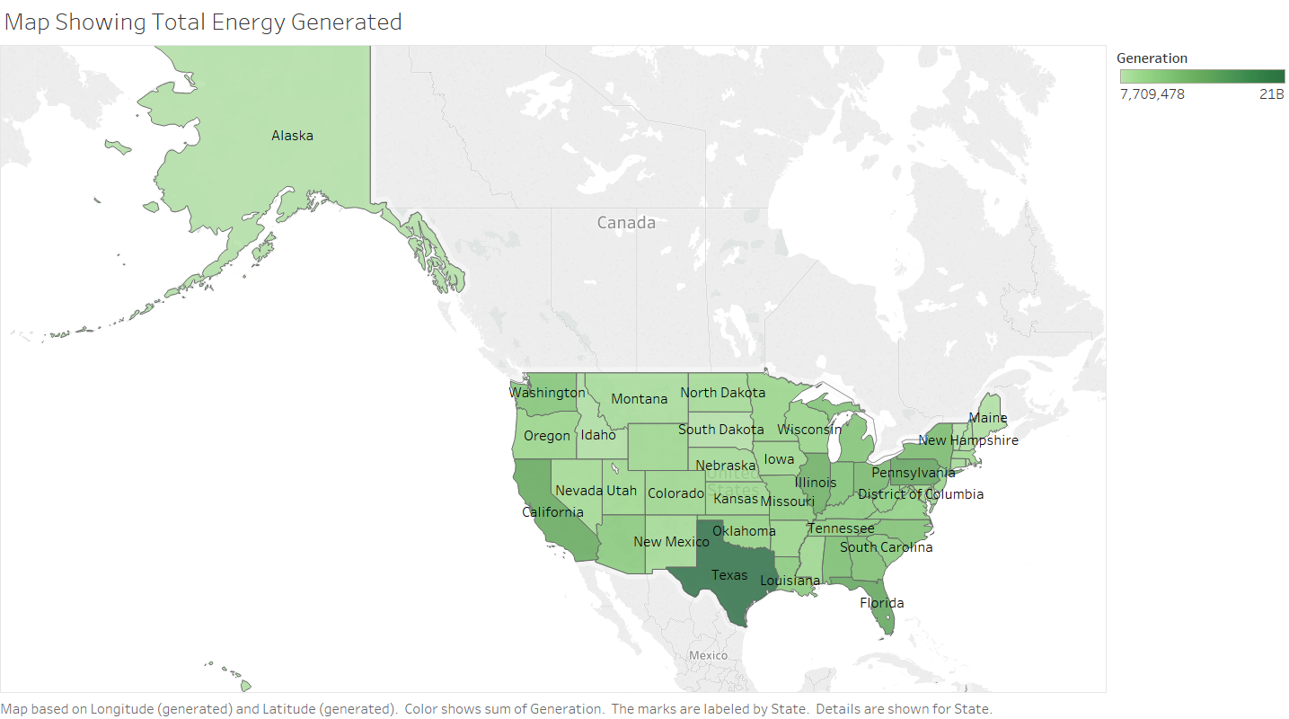
Map Showing Total Energy Generated

Slide 8
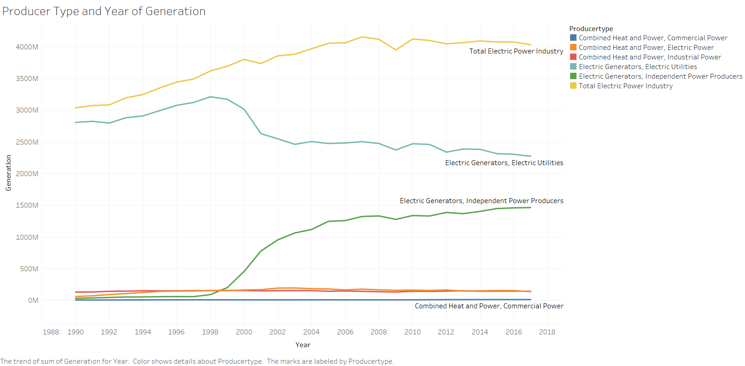
Producer Type and Year Of Generations

Slide 9
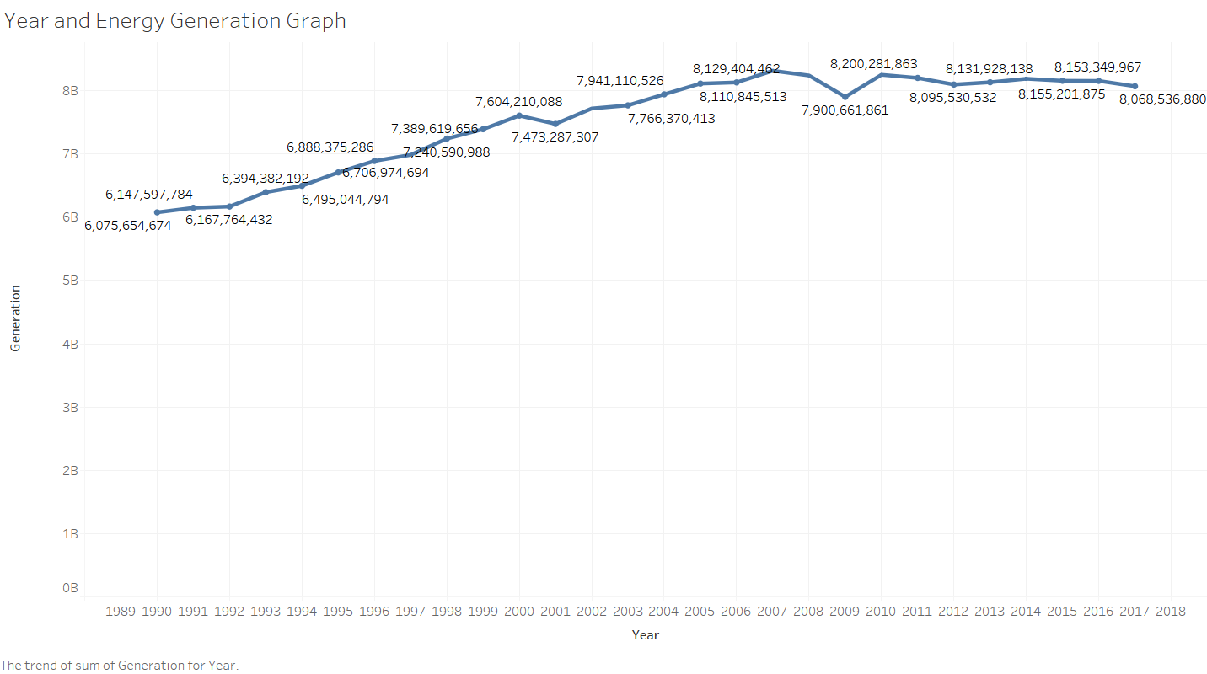
Year and Energy Generation Graph

Slide 10
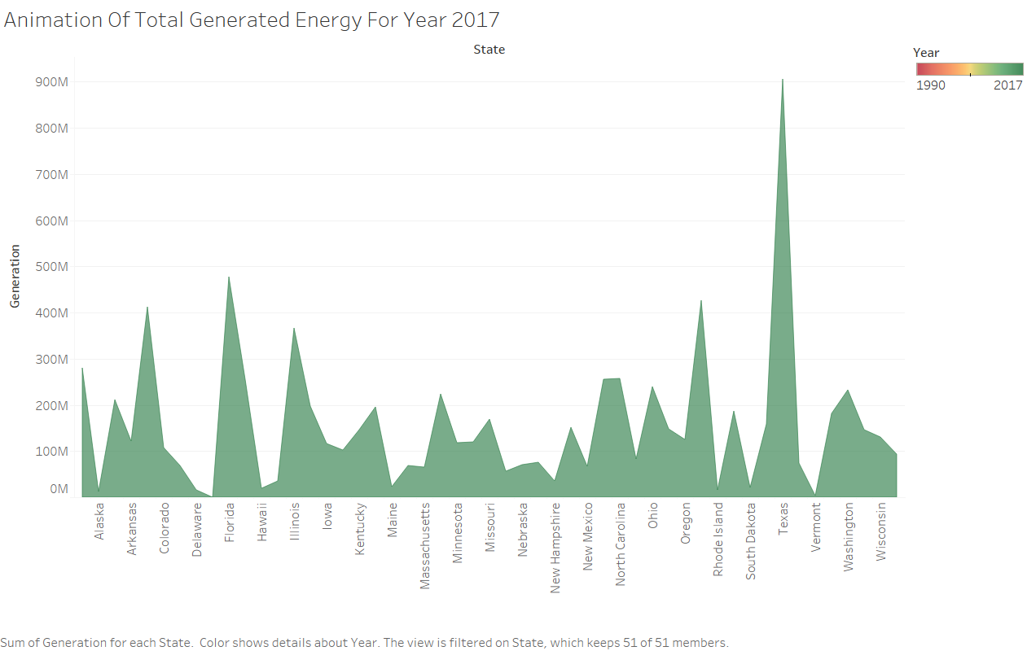
Animation Of Total Generated Energy

Slide 11
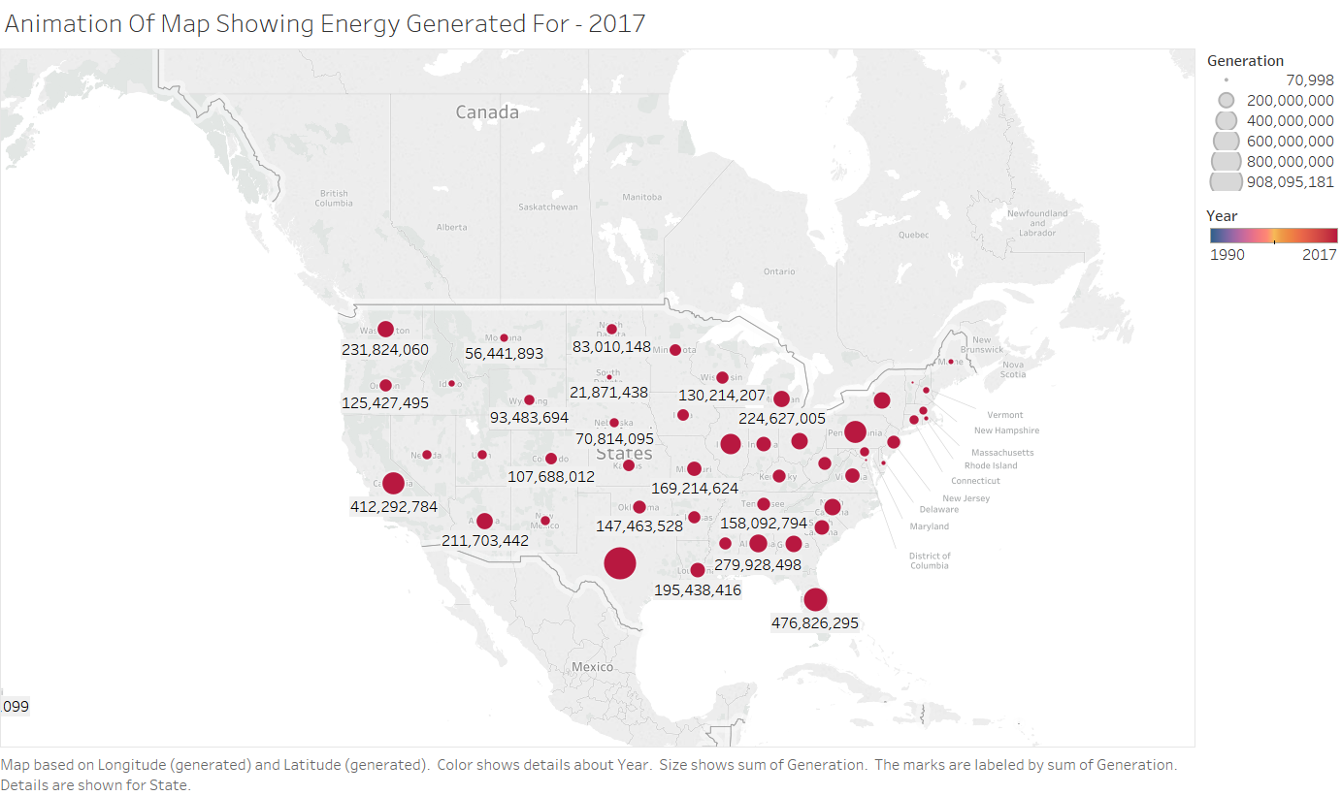
Animation Of Map Showing Energy Generated

Slide 12
Thank You

